Slide 1
MINI PROJECT
Smart Quiz with Leaderboard
A Flask web application that conducts a quiz, scores answers instantly and ranks players on a leaderboard.
Submitted by –
Prabudh Gautam · Kartik Sharma

Slide 2
Problem Statement
Conducting quizzes the traditional way is slow, manual and not very engaging.
Manual evaluation
Answer sheets must be checked by hand, which takes time and invites errors.
No instant result
Players wait for the checker before they know how well they did.
No competition
Without a ranking, there is little motivation to improve or play again.
Hard to update
Changing questions usually means editing code or reprinting papers.
2

Slide 3
Objective
1
Build a simple quiz website
Create an easy-to-use web quiz with Flask where a player enters a name and starts.
2
Keep questions editable
Load questions from questions.csv so they can be changed without touching the code.
3
Score automatically
Compare every answer with the correct one and show the score instantly.
4
Maintain a leaderboard
Save scores in leaderboard.csv and display the Top 5 players on the home page.
3

Slide 4
Flow of Our Website
1
Home page
/
Enter your name and see the Top 5
2
Quiz page
/quiz
Questions load from CSV as radio buttons
3
Submit
/submit
Answers are checked and score is counted
4
Save score
save_board()
Name and score are appended to the CSV
5
Result page
Leaderboard
Score, full ranking, Play Again
›
›
›
›
Play Again returns the player to the home page, so the loop can repeat.
4

Slide 5
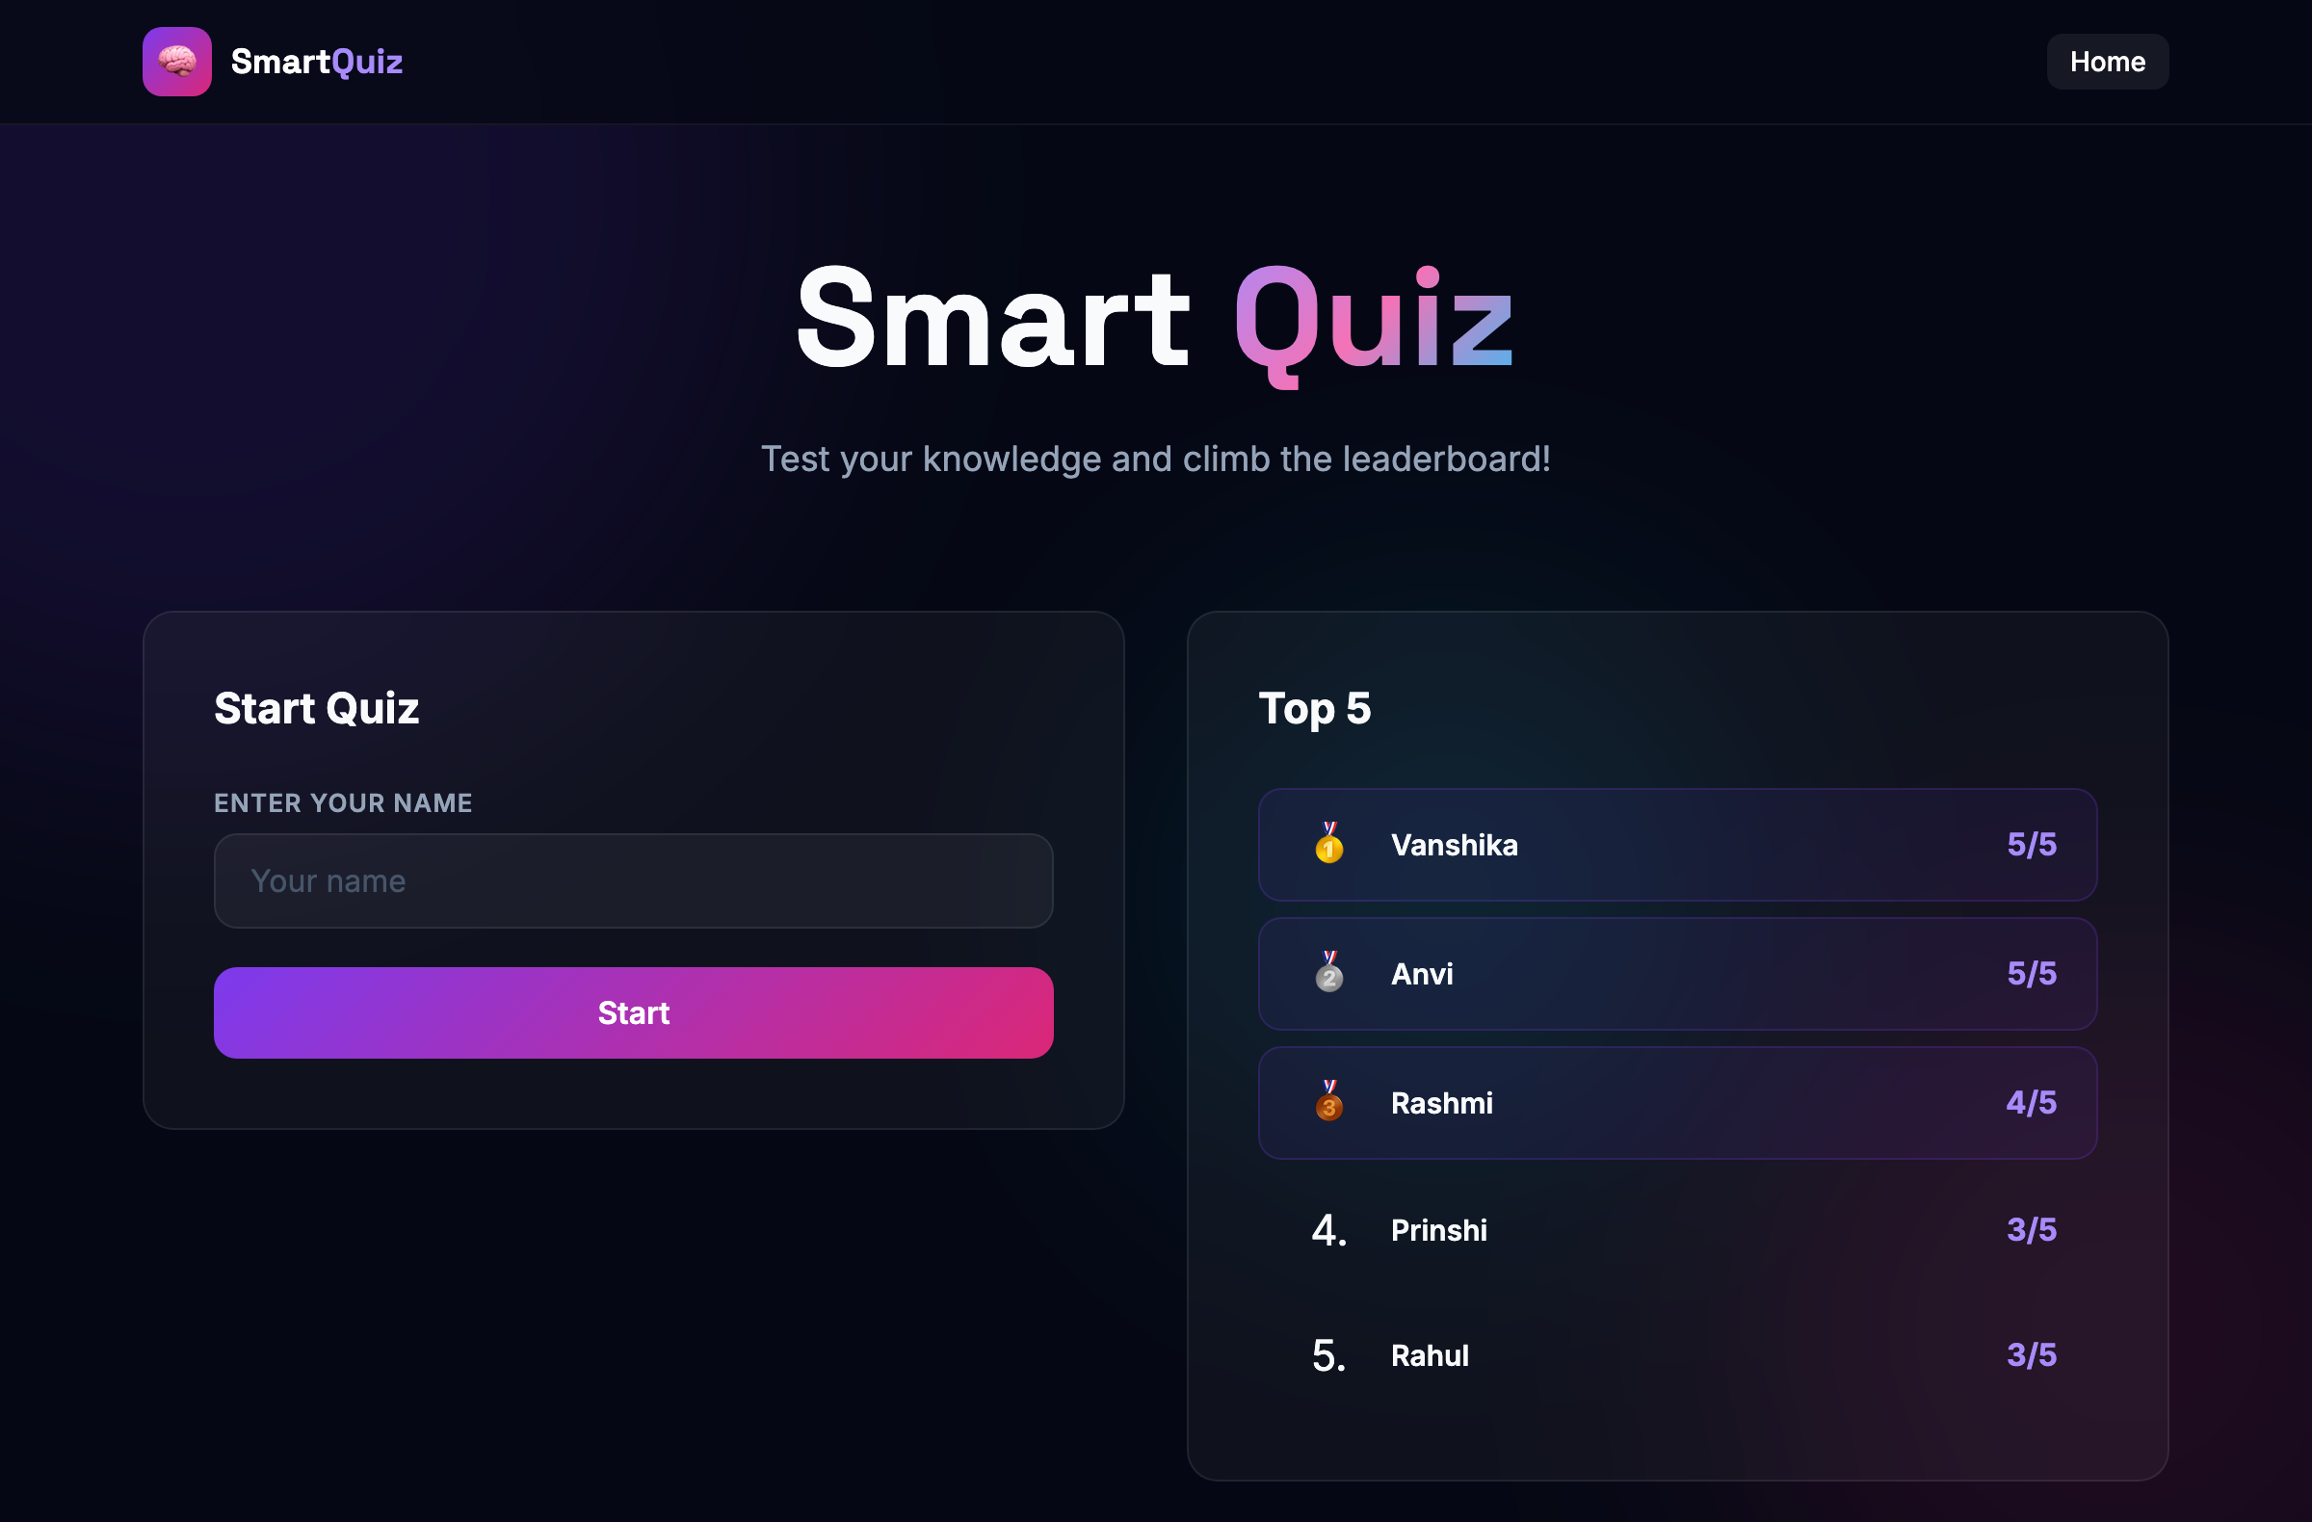
Home Page
5

Slide 6
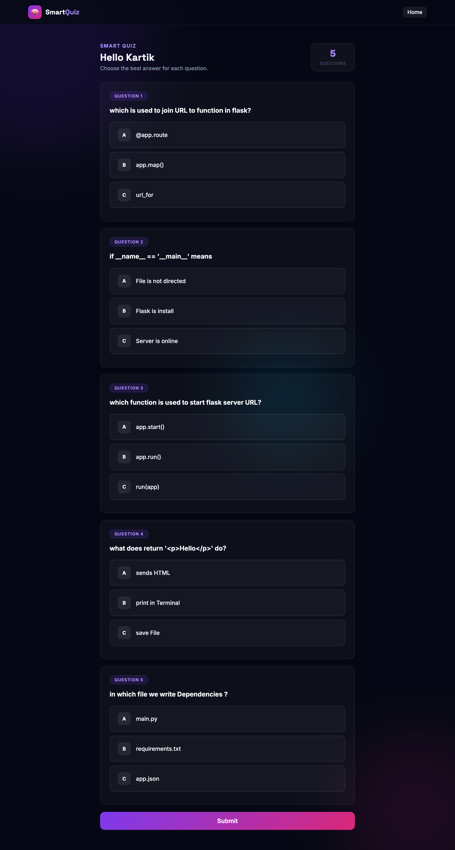
Quiz Page
Questions as radio buttons
• Questions are loaded from questions.csv
• Each question has three options — A, B, C
• The player's name is carried in a hidden field
• Every question is required before submitting
• Total questions update automatically from the CSV
6

Slide 7
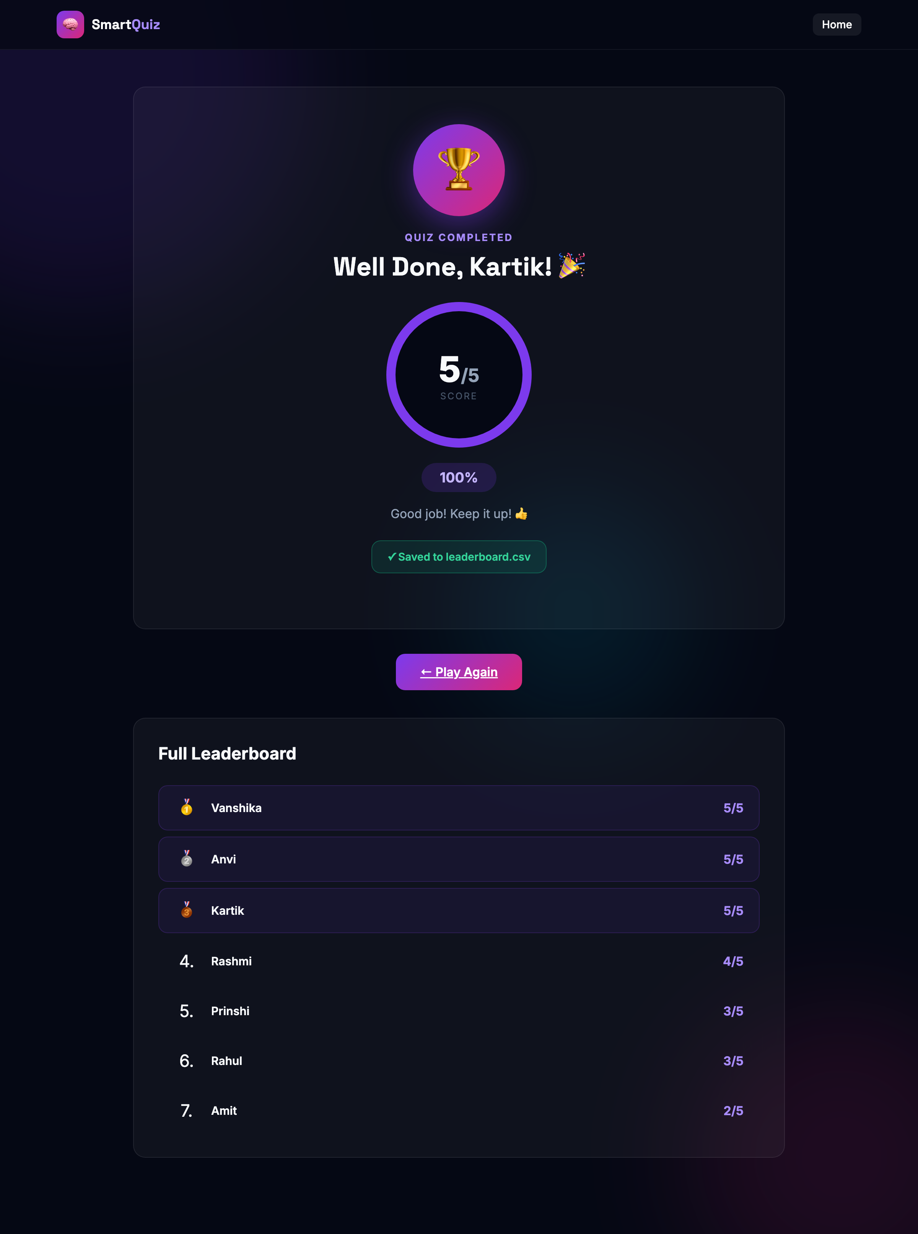
Result Page
Instant score & ranking
• Score is shown out of the total questions
• Score is saved to leaderboard.csv
• Full leaderboard with medals for the top 3
• Play Again returns to the home page
7

Slide 8
Technologies Used
Python 3
Core programming language
Flask
Routing, request, redirect
CSV module
Stores questions and scores
os module
Checks whether files exist
HTML
Quiz form and result pages
CSS
Dark card styling
Editor: Visual Studio Code
8

Slide 9
Project Structure
smart-quiz/
├── app.py # Flask server — all routes & functions
├── questions.csv # Quiz questions (q,a,b,c,ans)
├── leaderboard.csv # Player scores (name,score)
├── requirements.txt # Python dependencies
├── run_flask.sh # Convenience run script
├── README.md # Documentation
├── screenshots/ # UI screenshots
├── templates/
│ ├── base.html # Shared layout (navbar, background)
│ ├── index.html # Home page
│ ├── quiz.html # Quiz page
│ └── result.html # Result page
└── static/
└── style.css # Dark theme card styling
Simple by design
• One Flask file
• Two CSV data files
• Four HTML templates
• One CSS stylesheet
• No database required
9

Slide 10
Code: Imports & load_questions()
from flask import Flask, redirect, render_template, request
import csv
import os
app = Flask(__name__)
def load_questions():
# default questions if file not present
if not os.path.exists("questions.csv"):
return [ ... default questions ... ]
questions = []
file = open("questions.csv", "r", encoding="utf-8")
reader = csv.DictReader(file)
for row in reader:
q = {}
q["q"] = row["q"].strip()
q["a"] = row["a"].strip()
q["b"] = row["b"].strip()
q["c"] = row["c"].strip()
q["ans"] = row["ans"].strip().lower()
questions.append(q)
file.close()
return questions
questions = load_questions()
What it does
• Imports Flask, csv and os
• Falls back to default questions
• Reads each CSV row with csv.DictReader
• Cleans values with strip()
• Loaded once at startup
10

Slide 11
Code: Leaderboard & Routes
def load_board():
board = []
if not os.path.exists("leaderboard.csv"):
return board
f = open("leaderboard.csv", "r", encoding="utf-8")
reader = csv.reader(f)
for row in reader:
if len(row) == 2:
board.append([row[0], int(row[1])])
f.close()
board.sort(key=lambda x: x[1], reverse=True)
return board
def save_board(name, score):
f = open("leaderboard.csv", "a", newline="", encoding="utf-8")
writer = csv.writer(f)
writer.writerow([name, score])
f.close()
@app.route("/", methods=["GET", "POST"])
def home():
if request.method == "POST":
name = request.form.get("name", "Student").strip()
return redirect("/quiz?name=" + name)
board = load_board()
return render_template("index.html", board=board[:5], total=len(questions))
What it does
• load_board() sorts scores high to low
• save_board() appends name and score
• Home redirects to /quiz with the name
• Top 5 shown on the home page
11

Slide 12
Key Features
1
Web-Based
Runs in any browser, with no installation required for the user.
2
Instant Result
The score is calculated and displayed immediately after submission.
3
CSV Integration
Questions and leaderboard are handled through CSV files, so no database setup is needed.
4
Dynamic Scoring
The hardcoded “/5” was replaced with “/{len(questions)}”, so adding questions automatically updates the total.
5
Clean & Responsive UI
A dark theme card layout that is simple and user-friendly.
12

Slide 13
Future Scope
Database storage
Move from CSV files to SQLite or MySQL.
User login
Secure accounts so each player has a profile.
Timer
Add a countdown for each question or the whole quiz.
Categories and levels
Offer topics with easy, medium and hard difficulty.
Admin panel
Add and edit questions from the browser.
Online deployment
Host the app so anyone can play from anywhere.
13

Slide 14
Thank You
Smart Quiz with Leaderboard
Prabudh Gautam · Kartik Sharma

